Slide 1

Ruby on Rails

Slide 2
About today…
Ruby on Rails
Styling with CSS
Styling with Bootstrap

Slide 3

Styling with CSS

Slide 4
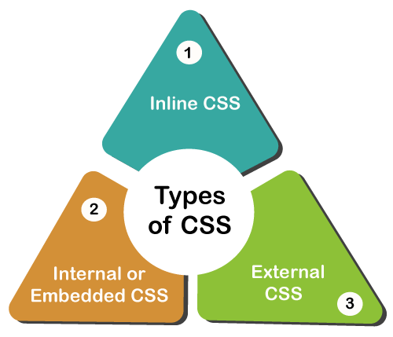
Overview
Using CSS (Cascading Style Sheets) to control the presentation of HTML elements
CSS can be applied in multiple ways :

Slide 5


Inline CSS
Styling is applied in the HTML tag directly

Slide 6
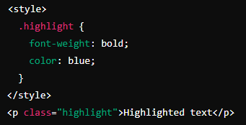

Embedded CSS
Write CSS between the <style> tag and then apply to the intended elements

Slide 7
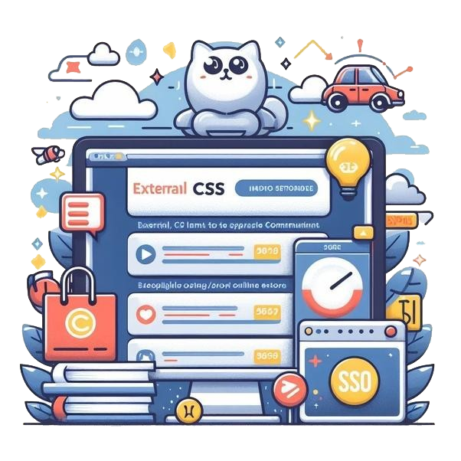
External CSS
Write CSS in a separate file and then link that file with rails file

Slide 8
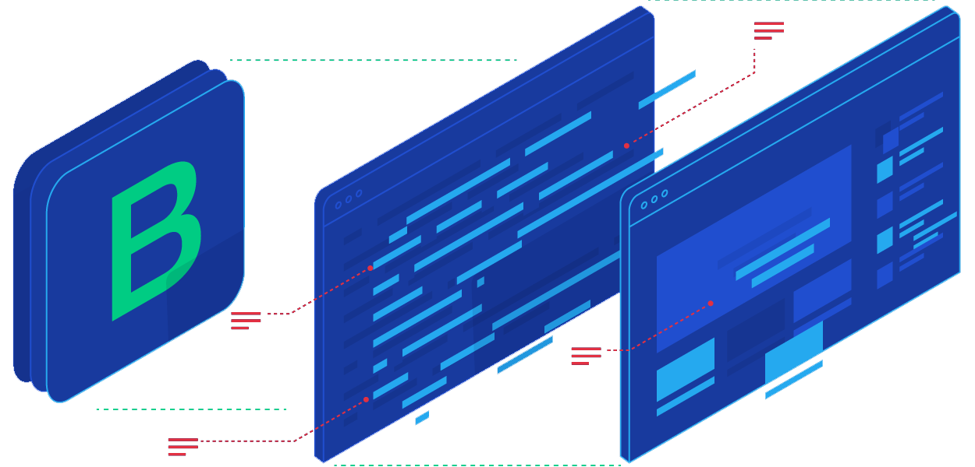
Intro to Bootstrap
Bootstrap is a popular CSS framework
Provides pre-designed components and utilities
For building responsive web interfaces

Slide 9




Add, Install and Configure
Add ‘bootstrap’ and ‘SASS Engine’ to Gemfile
Install dependencies
Import Bootstrap styles in assets/stylesheets/application.scss

Slide 10
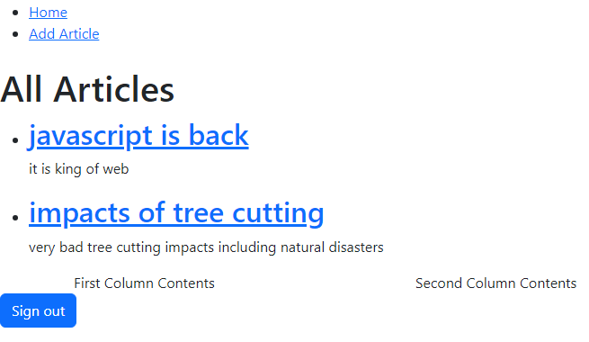
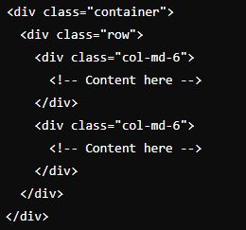
Apply Bootstrap

Slide 11


Slide 12

What is the purpose of using inline styles in HTML?
To apply unique styles directly to an element
Where is an internal stylesheet typically placed in an HTML document?
Within the <head> section
How can you integrate Bootstrap into a Rails application effectively?
By including Bootstrap files in the assets pipeline
Which HTML tag is used to link an external stylesheet to an HTML document?
<link>
In Rails views, how can you apply inline styles to an element?
By embedding CSS directly into the HTML tag

Slide 13

Task 1
Apply bootstrap styling in your Rails App

